Slide 1


COST OF FIRMS
Short run and long run cost structure of firms and output decisions

Slide 2
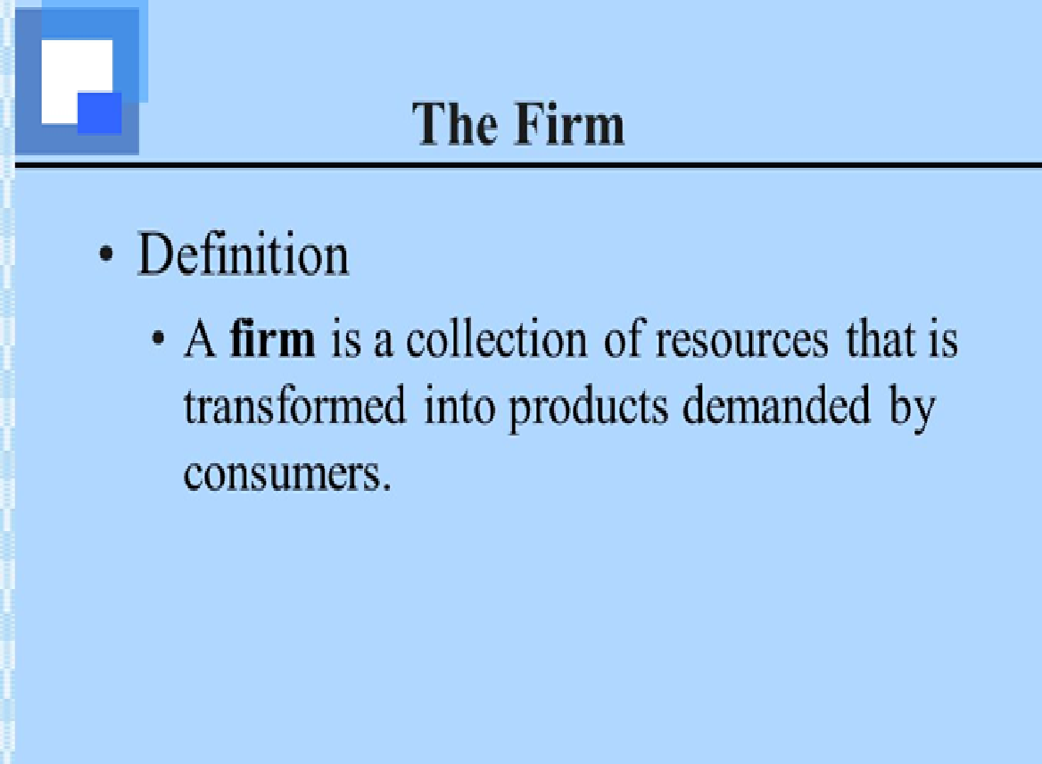
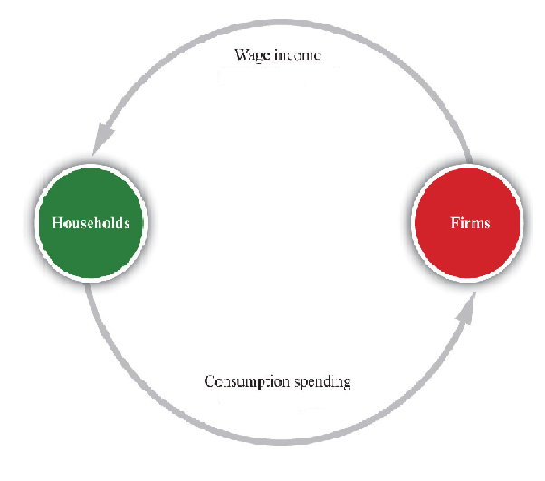
FIRM AND THE CIRCULAR FLOW OF INCOME

Slide 3
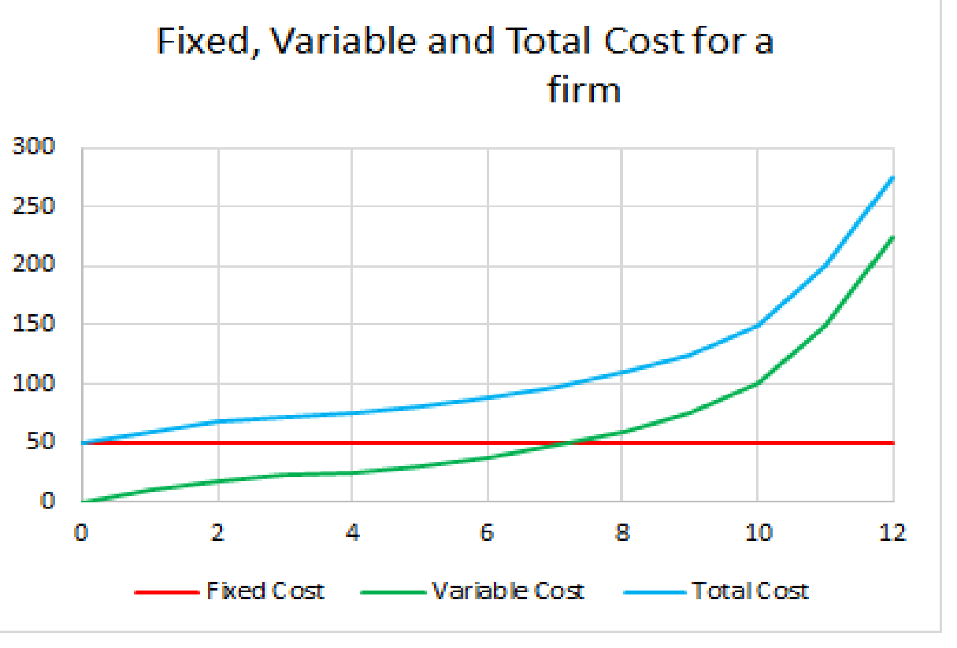
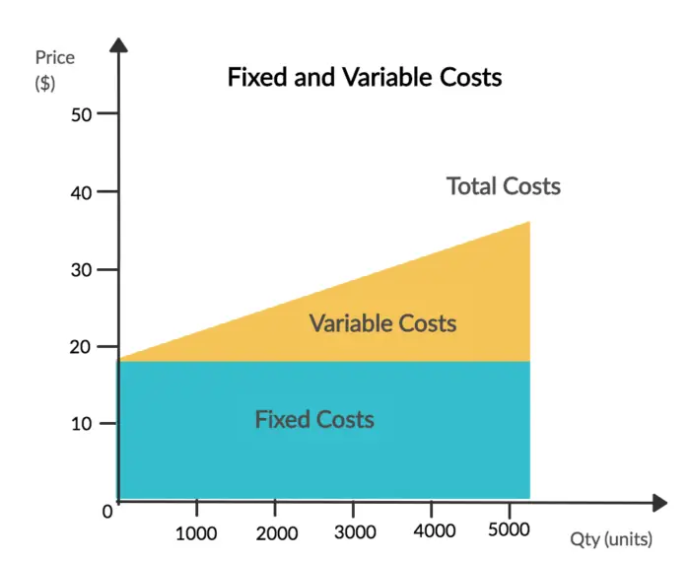
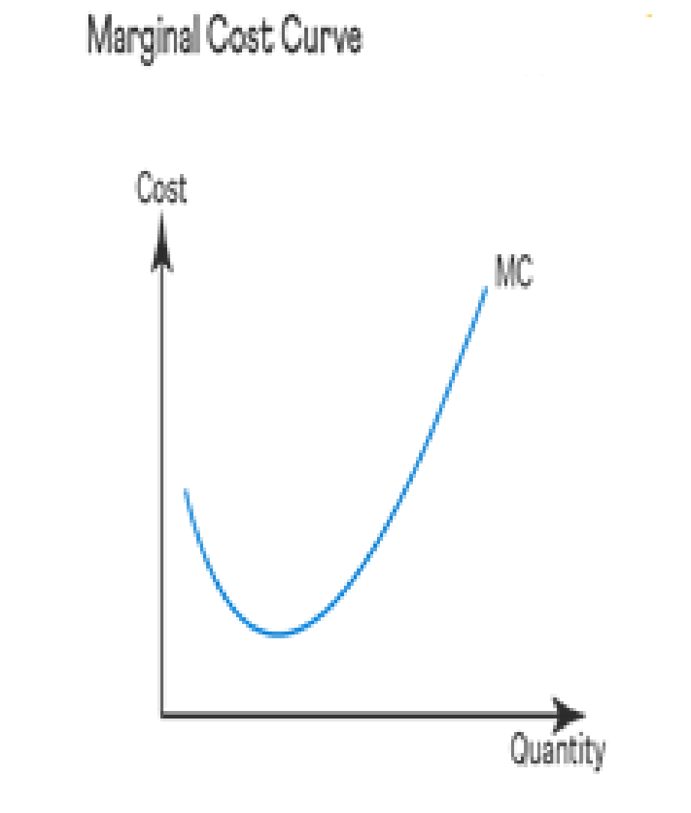
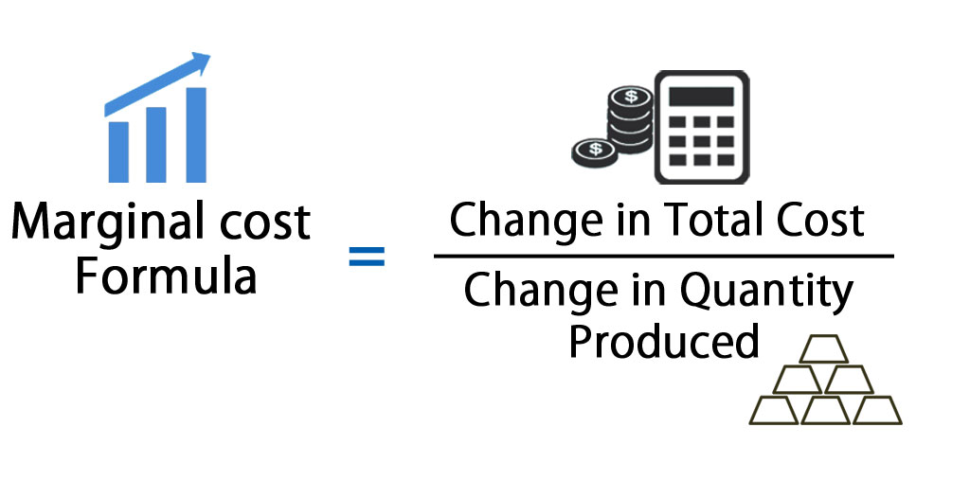
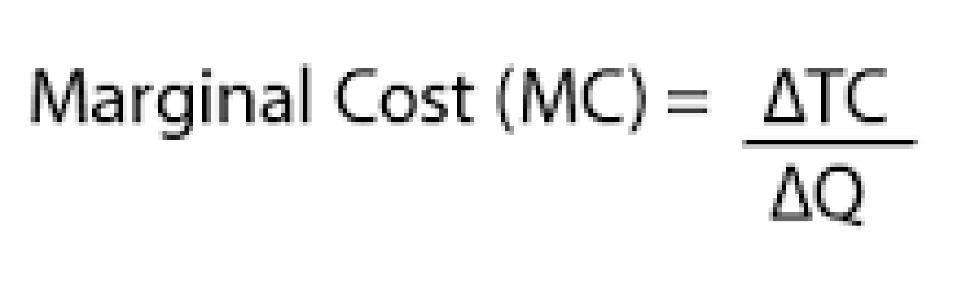
COST OF FIRMS
Firms have a number of different types of costs including fixed cost, variable cost, total cost and marginal cost. All of these different costs need to be considered when looking to figure out the costs to a firm.
TC = TFC + TVC

Slide 4
COST OF FIRMS
Firms also have costs including average fixed cost, average variable cost and average total cost.
Average fixed cost = Total fixed cost / The number of units produced
Average variable cost = Total variable cost / The output produced
Average total cost = Total cost / Output

Slide 5
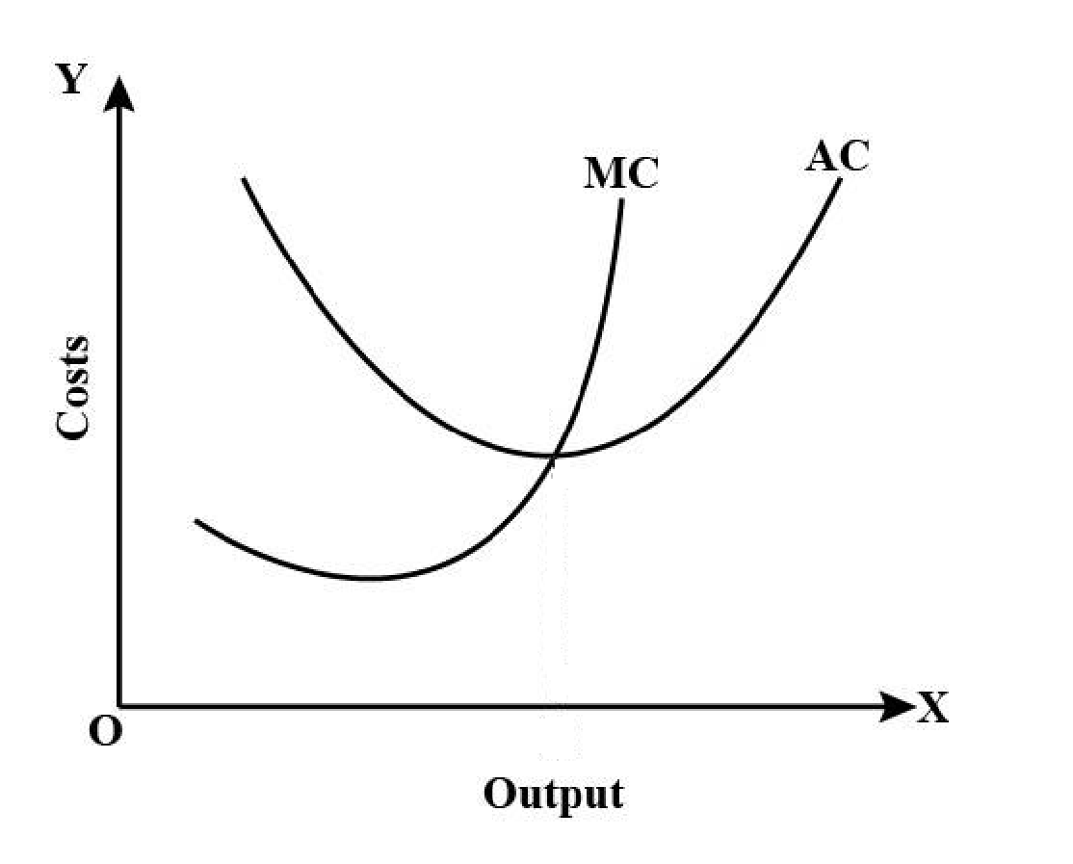
RELATION BETWEEN THE AVERAGE COST CURVES AND MARGINAL COST CURVES

Slide 6
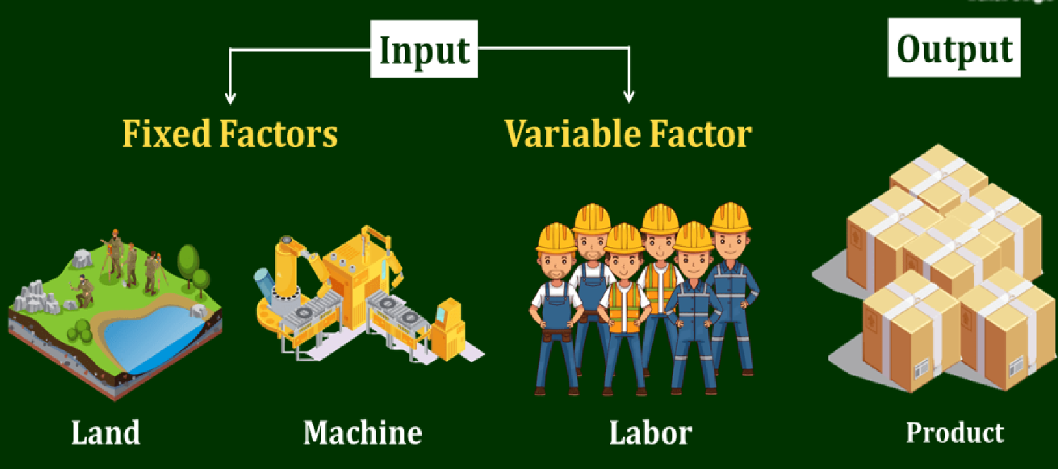
SHORT-RUN AND LONG-RUN COST STRUCTURE OF FIRMS AND OUTPUT DECISION

Slide 7
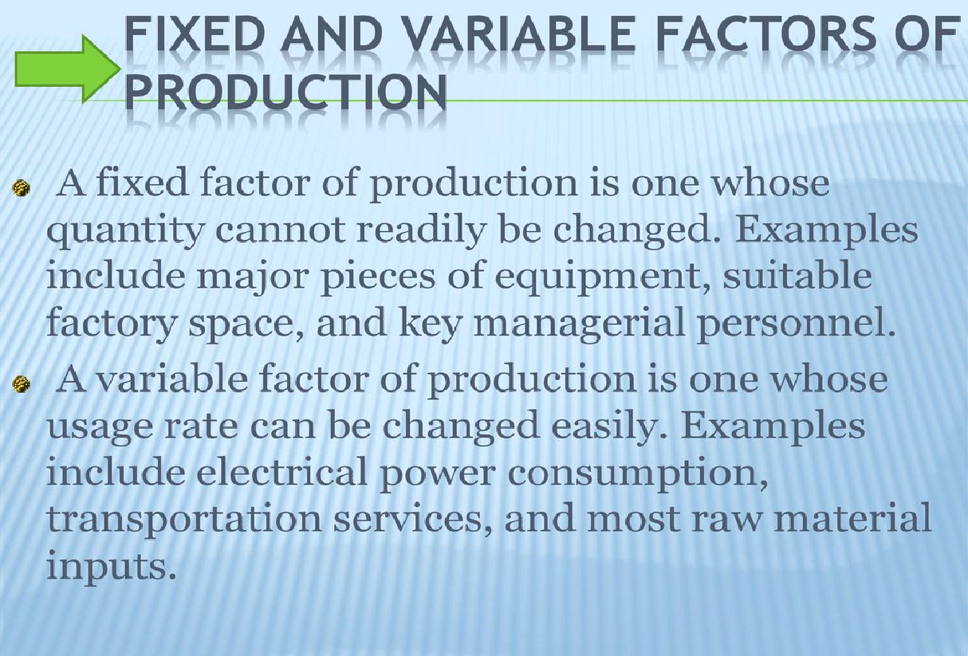

Slide 8
SHORT-RUN AND LONG-RUN DEFINED
The short-run is a period of time in which output can be increased or decreased by changing only the amount of variable factors such as labor, raw- materials, chemicals, etc. In the short-run, quantities of the fixed factors such as capital equipment , factory building, etc., cannot be varied for making changes in output.
The long-run is a period of time in which the quantities of all factors may be varied.

Slide 9
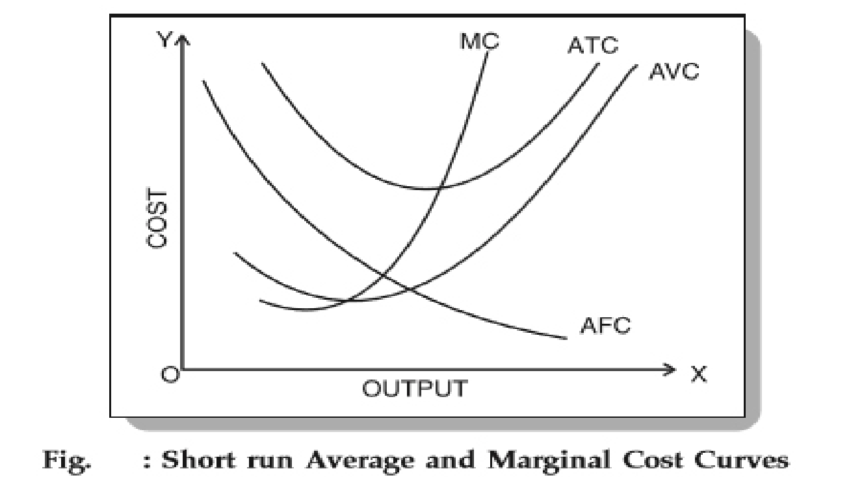
SHORT-RUN AVERAGE AND MARGINAL COST CURVES

Slide 10
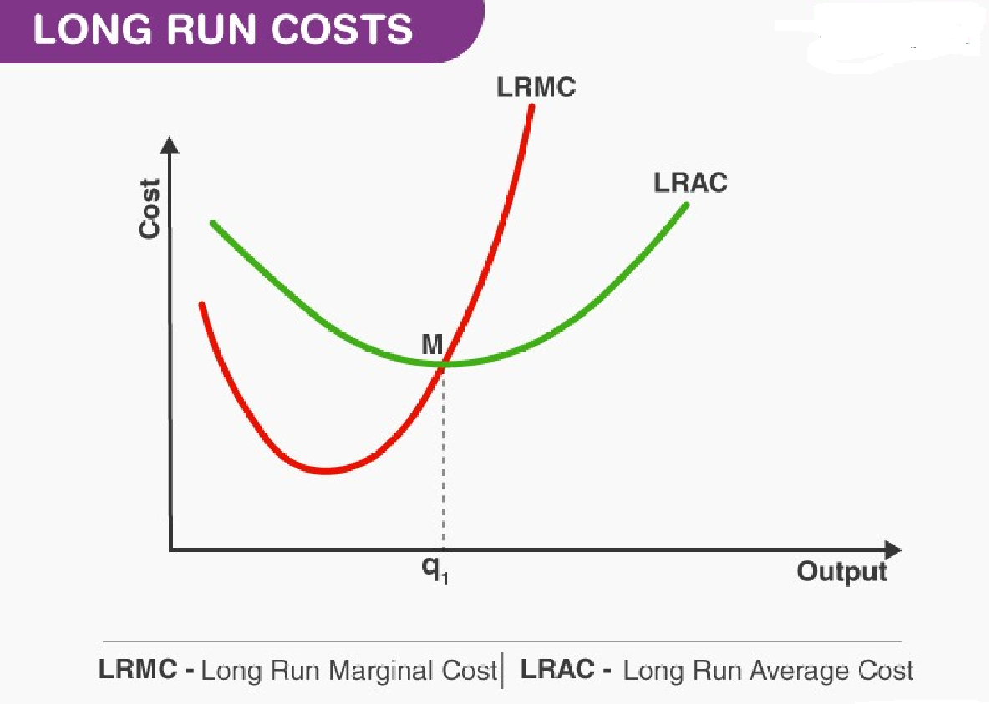
LONG-RUN COST CURVES

Slide 11
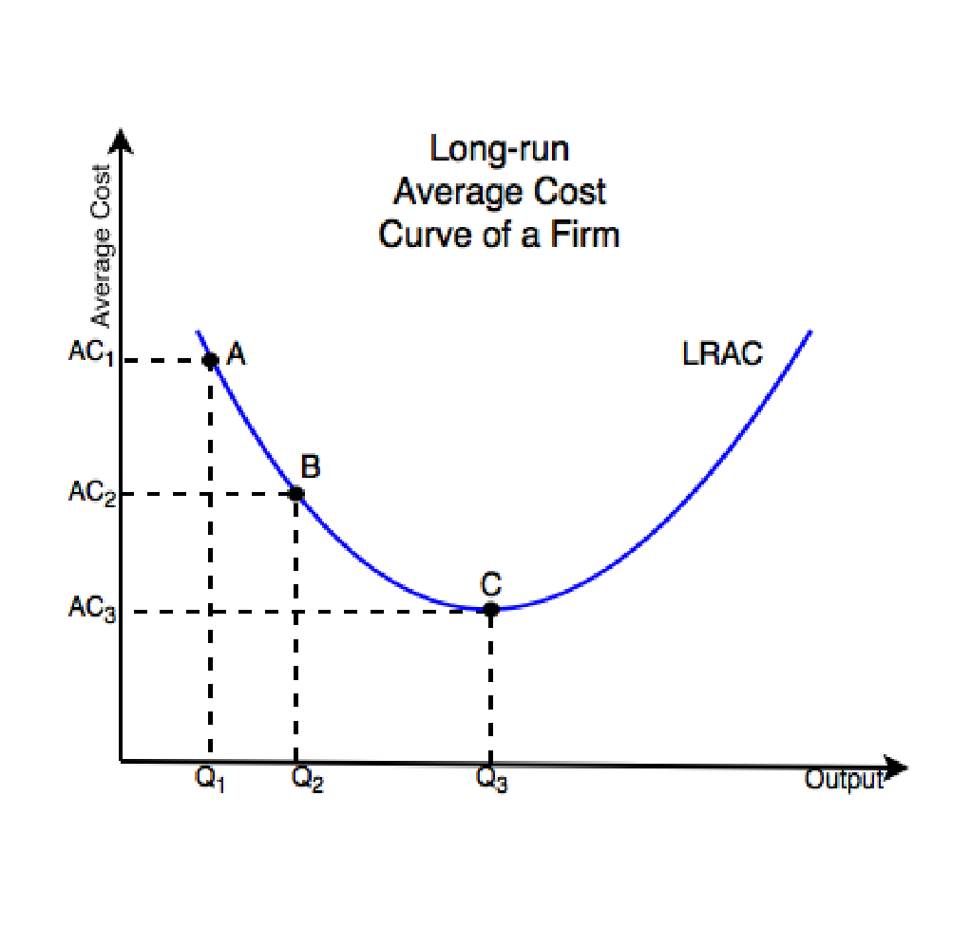
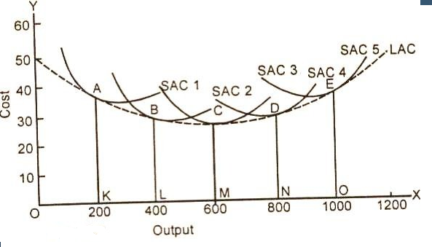
LONG-RUN AVERAGE COST CURVE AND LONG-RUN AVERAGE COST CURVE DERIVED FROM SHORT-RUN AVERAGE COST CURVES

Slide 12
CONCLUSION
Pricing and output decisions focus on where to set the price for the product and how much quantity to supply.

